Slide 1

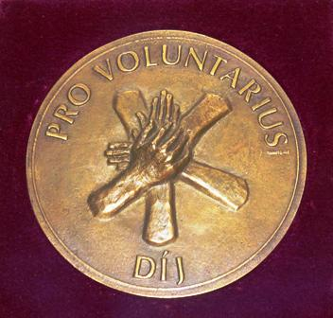

Introducing the 21 year old
Magic Lamp Foundation
www.csodalampa.hu
www.csodabogarak.com
www.facebook.com/csodalampa
www.youtube.com/csodalampi
www.instagram.com/csodalampaalapitvany
July 31, 2024

Slide 2
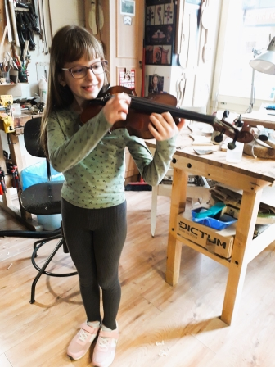
7 423 days = 5 000 realised dreams!
Magic Lamp Foundation has been granting wishes of children, suffering from life threathening illnesses, since November 2003.
We fulfilled the five thousandth dream, the dream of Zoé on March, 27, 2024, who would like to - and will - take violin lessons, and got also a beautiful violin.
One dream of an ill child has been fulfilled every 36 hours since 2003.

Slide 3

Our Mission
To give psychological support to life-threatheningly ill children by realising their dreams
We aim:
To grant a wish yearly, countrywide, to 240-300 very ill children
To give psychological and mental support through the joy caused by the fulfilled wish to the child and parents
To assist in and help the healing work of doctors
„Educating” the future generations in solidarity, empathy and donations culture
JOY
STRENGTH
HEALING

Slide 4

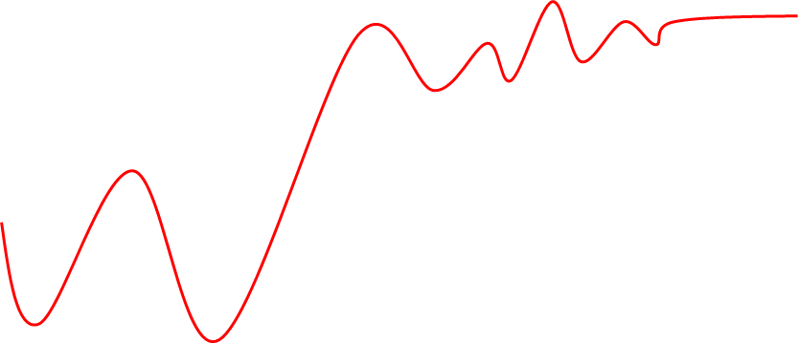
A Csodalámpa hatása a gyógyulás lelki támogatásával
Magic Lamp’s psychological effect in the healing process
Theraphy
chosen
1
2
3
4
5
DIagnosis
Refusal
Acceptance
Rehabilitation, follow-up
Mental stages
Idő / Time
Csodalámpa nélkül…
Without Magic Lamp’s involvement
Sokk Tagadás és Depresszió Remény a gyógyulásra Gyógyulás öröme
Shock Denial and Depression Hope for remission Recovery

Slide 6
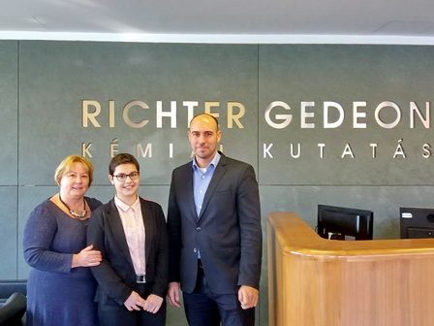
We grant more wishes per year, than the number of working days!
Milestones
2003: founding charter, the first two wishes granted
2005: first time in national media
2006. building a nationwide wish-granting network
2007: since then pro-bono audit by PwC
2009: the 1000th wish fulfilled
2013: Superbrands and MagyarBrands ‚Special Prize for Children’
2016: the 3000th wish granted; launching the ‚Magic Bugs’ (Csodabogarak.com) crowdfunding program and site
2019: Pro Voluntarius state award
2020: even amid the COVID restrictions we granted 227
new wishes – among them the 4000th!
2021: Healing with Magic’ gets momentum
2022: 309 fulfilled wishes; ‚Healing w. Magic’ introduced
in 12 big country ped. clinics
2023: 320 wishes granted; international cooperation started
with Czeh, Estonian, Polish and Spanish wish granting foundations

Slide 7
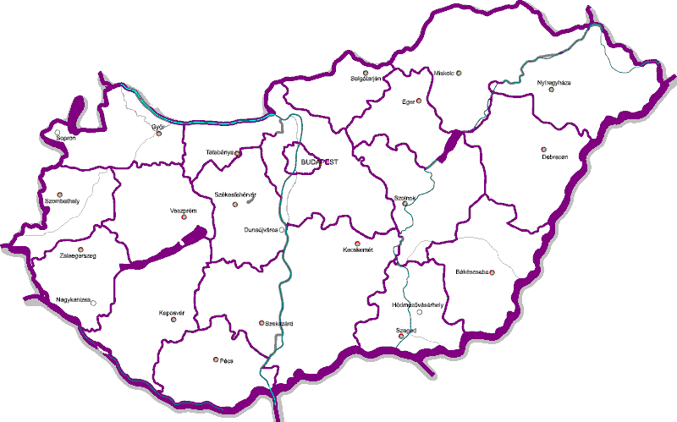

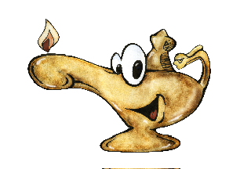
Our national wish-granting network
Budapest
Miskolc
Debrecen
Szeged
Pécs
Szombathely
Veszprém
Zalaegerszeg
Kaposvár - Mosdós
Nyíregyháza
Kecskemét

Slide 8
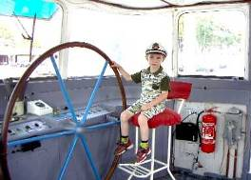
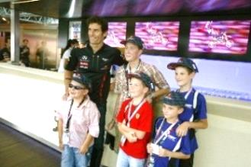
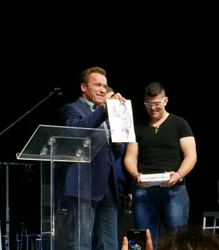
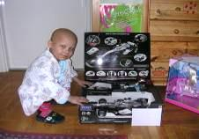
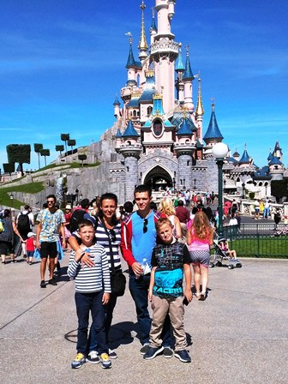
What can one wish?
Special experiences
  Travel, performances, concerts, ZOO visit, etc.
Activities
  horseriding, driving a tank, etc.
Meeting famous people
„Objects” (handy, camera, toys…)

Slide 9
Process of the wish granting
Reporting an ill children
Contacting the child
Decision
By the child, parent,
medical staff, members of our network
Magic Lamp office and ML network: doctors, parents
Magic Lamp office, Board of trustees, Supervisory Board,
verifications and ascertaining the wish
„Post-production”
Wish granting
☺
Organising the fulfilment
Magic Lamp office and network (coordinators)
Nationwide wish- granting network
Magic Lamp office and network (coordinators)
Publishing a report, accounting, thanking the sponsors
coordinations, execution, documenting
Funding, procurement, travel organisation, etc.

Slide 10
Income structure
1%
Company donations
Private donations
„Magic Bugs”
In kind:
Human resources
Volunteer work

Slide 11
Expenditures of Magic Lamp
Costs of wished objects
Costs of organising the wishes
Costs of the national wish-granting network
Campaign costs
Includes the cost of running the country-wide wish-granting network: reimbursements, training, events, hardware, costs of communication

Slide 12
Healing with Magic
A very special rehab program based on David Copperfield’s ‚Project Magic’ that teaches magic tricks to the child-patients.
The tricks are chosen to fit to the illness and to support the medical rehab process
  Our volunteer magicians teach the tricks to the medical personnel, who teach them to the patients
To learn and execute the different tricks on needs motoric skills, concentration, fast thinking – all this gives the in-patients new skills, fun, special knowledge that helps them to reintegrate their ‚normal milieu’ after their healing.
End of 2023 the program is running in 15 different pediatric clinics countrywide.

Slide 13
What can we offer to our partners?
First of all, the possibility to make life-threateningly ill children happy and help their recovery!
The fulfillment of wishes through a countrywide network of 202 volunteers (including ascertaining the wish, obtaining medical and parental consents, securing the funds, ensuring background medical support, fulfilling the wish, accounting and documentation of the costs, and providing feedback to sponsors)
Support to CSR activities of companies through the strengthening of donation culture; organization of team-building events combined with donations, in areas such as gastronomy, sports and handcrafting; occasional personal participation in granting of wishes; and a long-term partnership in which we provide substantial publicity to our donors
Providing an opportunity to make donations, taking advantage of tax allowance, and ensuring full transparency

Slide 14
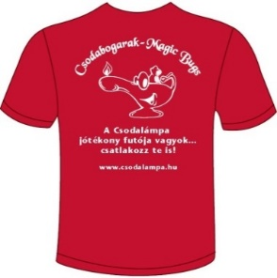
Who are the Magic Bugs?
  Private persons, sportsmen:
  Collecting, organising small amount donations for Csodalámpa (crowdfunding) at sports and other events
  Assisting us in our yearly 1% campaign
  Spreading the word about Magic Lamp Foundation
    among colleagues, friends, acquintances
    they take part in huge sports events in „Magic Bug” T-shirts
    www.csodabogarak.com
  Our charitable Ambassadors:
  High level managers, who help the development and long-term success of Csodalámpa by their managing or other special knowledge, business and private connections

Slide 15
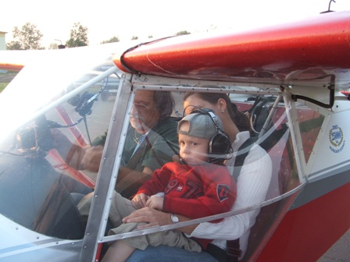
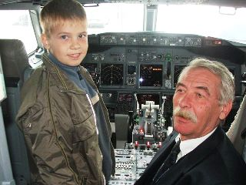
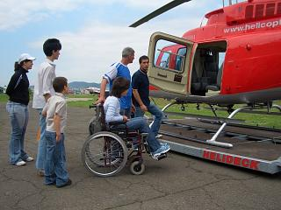
Nothing is impossible with your support!
THANK YOU for your help!

